Slide 1

ECE 1710: Power Distribution Engineering and Smart Grids
Lecture 11
Dr. Robert Kerestes
University of Pittsburgh
Swanson School of Engineering
Department of Electrical and Computer Engineering
Notes:
Instructions for editing school and department titles:
Select from menu: View > Master > Slide Master
Click on each text area you wish to edit. Text will become editable.

Slide 2
Outline
Outline of Lecture No. 11
Module #1: The modified line and approximate line segment models
Module #3: Modified ladder iterative technique
Module #3: Modified ladder iterative technique example

Slide 3
Learning Objectives
Learning Objectives:
State the assumption made in the modified line model and why these assumptions can be justified
Solve for voltage drops three-wire delta connected distribution lines
Solve for ground current in three-phase distribution lines
Produce an approximate phase impedance matrix using a sequence impedance matrix
Solve for voltages and currents in a simple system with a transmission line given loading data

Slide 4
Module #1
The modified line and approximate line segment models

Slide 5
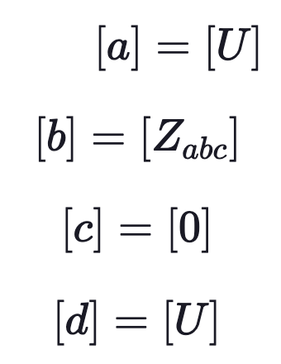
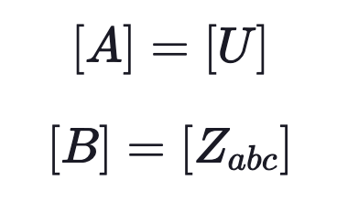
The Modified Line and Approximate Line Segment Models
Module #1
Note that in Kersting’s book, he will sometimes refer to and use the modified line model i.e.

Slide 6
The Modified Line and Approximate Line Segment Models
Module #1
We will not use the modified line model and will focus on the exact model. However, we will compare our results to the modified model so you should know what it consists of.

Slide 7
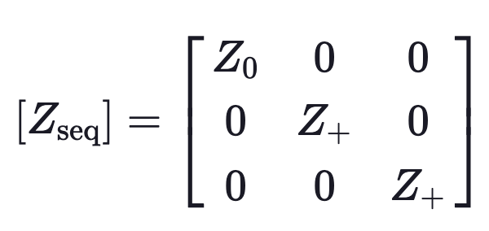
The Modified Line and Approximate Line Segment Models
Module #1
Many times the only data available for a line segment will be the positive and zero sequence impedances as shown below:

Slide 8
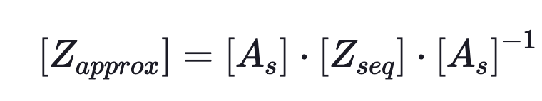
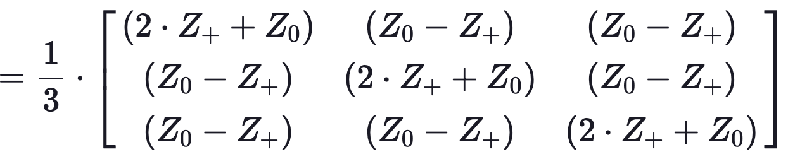
The Modified Line and Approximate Line Segment Models
Module #1
The approximate line model can be developed by applying the “reverse impedance transformation” from symmetrical component theory:

Slide 9
The Modified Line and Approximate Line Segment Models
Module #1
We can then use Z_{approx} as being equivalent to Z_{abc} and analysis can be peformed using the [a], [b], [c], [d], [A] and [B] matrices for the modified line model (since that is all the data we are given).

Slide 10
The Modified Line and Approximate Line Segment Models
Module #1
Question: (True or False) We can get a good approximation of the phase impedance matrix if we only have sequence impedance data.

Slide 11
The Modified Line and Approximate Line Segment Models
Module #1
Question: (True or False) The matrix [c] can be approximated to be essentially equal to zero regardless of how long the line is

Slide 12
Modified ladder iterative technique
Module #2

Slide 13
The Modified Ladder Iterative Technique
Module #2
Previous example problems have assumed a linear system. Unfortunately, that will not be the usual case for distribution feeders.
When the source voltages are specified and the loads are specified as constant kW and kvar (constant PQ), the system becomes nonlinear, and an iterative method will have to be used to compute the load voltages and currents.
We will develop a simple form of the ladder iterative technique in order to demonstrate how the nonlinear system can be evaluated.

Slide 14
The Modified Ladder Iterative Technique
Module #2
The ladder technique is composed of two parts:
Forward sweep
Backward sweep

Slide 15
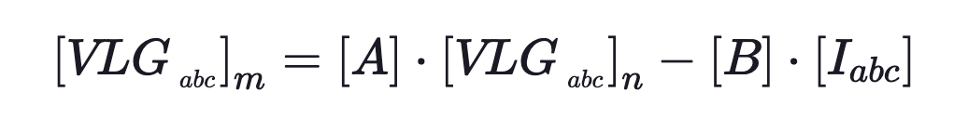
The Modified Ladder Iterative Technique
Module #2
The forward sweep computes the downstream voltages from the source by applying:
To start the process, the load currents [I_{abc}]_{m} are assumed to be equal to zero and the load voltages are computed. In the first iteration the load voltages will be the same as the source voltages.

Slide 16
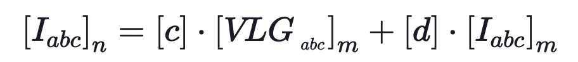


The Modified Ladder Iterative Technique
Module #2
The backward sweep computes the currents from the load back to the source using the most recently computed voltages from the forward sweep. The equation applied for this sweep is:
Since this is the modified sweep, we can say $[c]≈0$, and hence

Slide 17
The Modified Ladder Iterative Technique
Module #2
After the first forward and backward sweeps, the new load voltages are computed using the most recent currents.
The forward and backward sweeps continue until the error between the new and previous load voltages is within a specified tolerance.

Slide 18
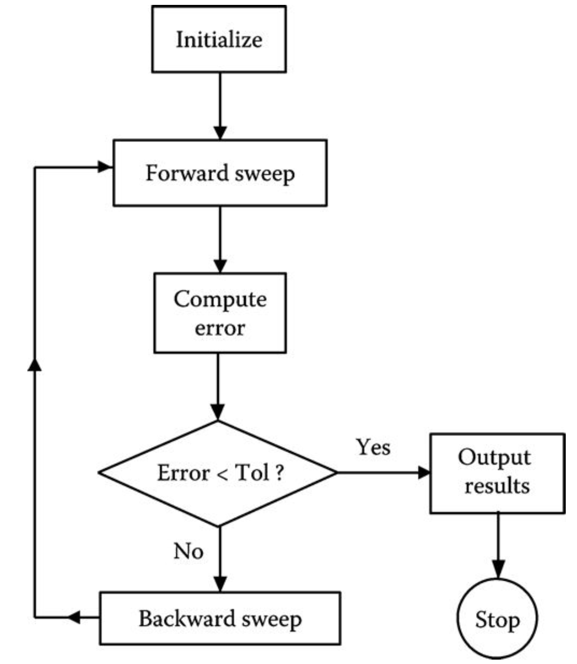
The Modified Ladder Iterative Technique
Module #2
Modified ladder iterative algorithm flowchart

Slide 19
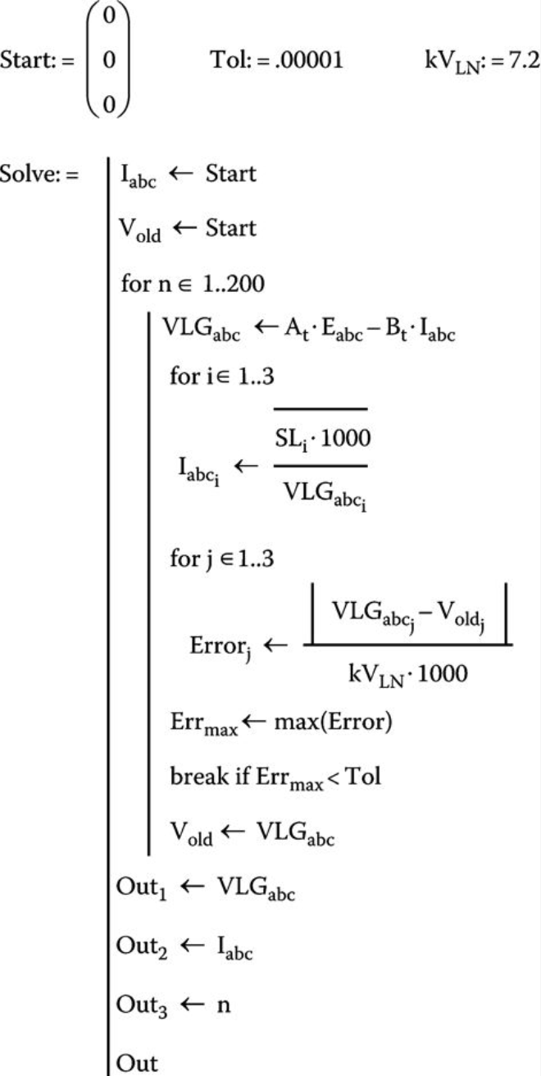
Module #2
Modified ladder iterative algorithm Mathcad script

Slide 20
The Modified Ladder Iterative Technique
Module #2
Question: In the ladder iterative technique we will continue to iterate until
The input current at node n and the output current at node m are equal to one another
Voltage unbalance at the receiving end of the line is within tolerance
The forward sweep and the backward sweep produce the same result
The old voltages and the new voltages for a given iteration are close enough to be considered “equal”

Slide 21
The Modified Ladder Iterative Technique
Module #2
Question: The modified ladder iterative technique solves for
Receiving end power given initial load voltages and currents
Sending end power given initial load voltages and currents
Receiving end voltages given sending end voltages and receiving end power
Receiving end and currents given receiving end voltage and power

Slide 22
Module #3
Modified Ladder Iterative Technique Example

Slide 23
Modified Ladder Iterative Technique Example
Module #3
Example: The line on the next slide serves an unbalanced three-phase load of
Phase a: 2500 kVA and PF = 0.9 lagging
Phase b: 2000 kVA and PF = 0.85 lagging
Phase c: 1500 kVA and PF = 0.95 lagging
The source voltages are balanced 12.47 kV.

Slide 24
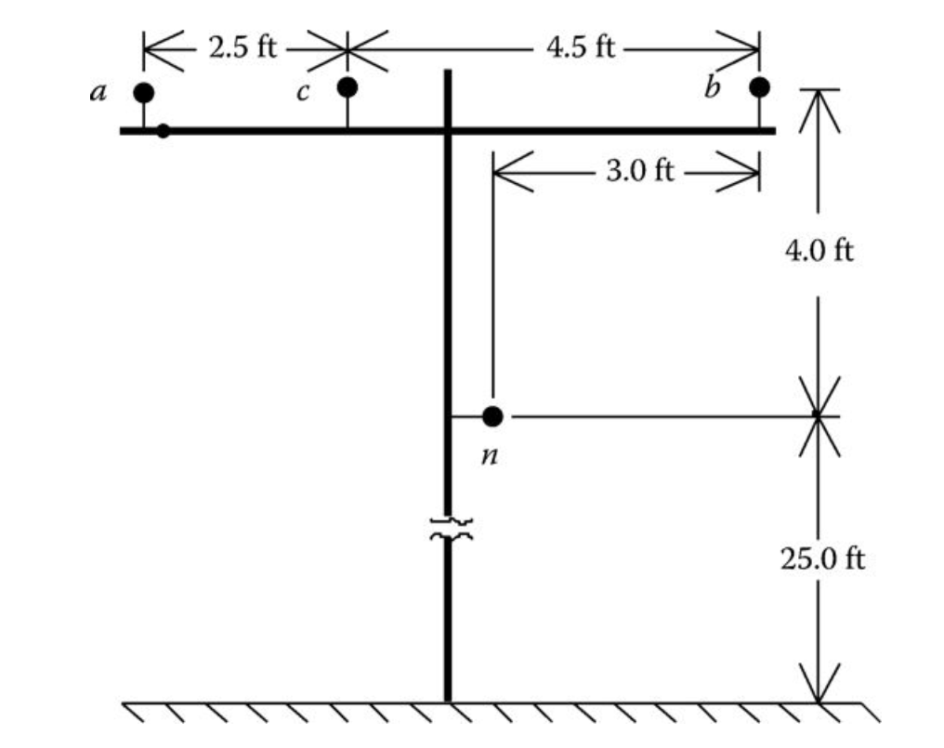
Modified Ladder Iterative Technique Example
Module #3
Phase conductors:
336,400 26/7 ACSR
Neutral conductor:
4/0 6/1 ACSR

Slide 25
Modified Ladder Iterative Technique Example
Module #3
Initializing the currents and voltages

Slide 26
Modified Ladder Iterative Technique Example
Module #3
Initializing the load currents and voltages
Vlg_m_init =
0
0
0
Im_init =
0
0
0

Slide 27
Modified Ladder Iterative Technique Example
Module #3
Calculating the forward sweep equation
$${\left[{VLG}_{abc}\right]}_{m}=\left[A\right]{\left[{VLG}_{abc}\right]}_{n}−\left[B\right]{\left[I_{abc}\right]}_{m}$$

Slide 28
Modified Ladder Iterative Technique Example
Module #3
Forward sweep results. Source and load have about the same voltages on first pass:
abs(Vlg_m)
ans =
1.0e+03 *
7.1996
7.1996
7.1996
angle(Vlg_m)*180/pi
ans =
-0.0002
-120.0002
119.9998

Slide 29

Modified Ladder Iterative Technique Example
Module #3
Then use the forward sweep voltage to update the load current using
$$I_{i,m}={\left(\frac{S_{i}}{V_{i,m}}\right)}^{∗}$$
where i represents the phase i.e. a, b, or c.

Slide 30
Modified Ladder Iterative Technique Example
Module #3
The load currents are then:
abs(Im)
ans =
347.2407
277.7929
208.3445
angle(Im)*180/pi
ans =
-25.8421
-151.7886
101.8049

Slide 31
Modified Ladder Iterative Technique Example
Module #3
Computing the error
$${\text{error}=\left[{VLG}_{abc}\right]}_{m}−{\left[{VLG}_{abc}\right]}_{m_old}$$

Slide 32
Modified Ladder Iterative Technique Example
Module #3
Error on first pass should be roughly equal to the source voltage:
error =
1.0e+03 *
7.1996
7.1996
7.1996

Slide 33
Modified Ladder Iterative Technique Example
Module #3
Check if max error is less than tolerance, if so then exit and output, if no proceed to backward sweep

Slide 34
Modified Ladder Iterative Technique Example
Module #3
Max error is greater than tolerance:
max(error)
ans =
7.1996e+03
tol =
1.0000e-03

Slide 35
Modified Ladder Iterative Technique Example
Module #3
Calculate backward sweep equation
$${\left[I_{abc}\right]}_{n}=\left[c\right]{\left[{VLG}_{abc}\right]}_{m}+\left[d\right]{\left[I_{abc}\right]}_{m}$$

Slide 36
Modified Ladder Iterative Technique Example
Module #3
Backwards sweep then calculates the source current
abs(In)
ans =
347.1845
277.7438
208.3214
angle(In)*180/pi
ans =
-25.8288
-151.7696
101.8281

Slide 37
Modified Ladder Iterative Technique Example
Module #3
Return and perform the loop again.

Slide 38
Modified Ladder Iterative Technique Example
Module #3
This continues until the max error is less than the tolerance:
Iteration | Max Error
1 | 7.1996e+03
2 | 466.2134
3 | 49.7729
4 | 4.7746
5 | 0.6473
6 | 0.0674
7 | 0.0097
8 | 0.0010
9 | 0.1505e-3

Slide 39
Modified Ladder Iterative Technique Example
Module #3
Producing the final solution:
abs(Vlg_m)
ans =
1.0e+03 *
6.6781
6.9730
7.0555
angle(Vlg_m)*180/pi
ans =
-2.3274
-122.1311
118.7458

Slide 40
Modified Ladder Iterative Technique Example
Module #3
Producing the final solution:
abs(Im)
ans =
374.3562
286.8193
212.6004
angle(Im)*180/pi
ans =
-28.1694
-153.9195
100.5509

